Slide 1

Front End Engineering-II Project
Team Details :-
Hardik Jain (2310991837)
Khushi Chauhan(2310991872)
Lovish Monga (2310991886)
Kashish Sharma (2310992574)
Faculty Coordinator:-
Thirupathy M
Dr Yogesh
Chitkara University Institute of Engineering and Technology, Chitkara University, Punjab

Slide 2
Project Abstract
Project Name : MEDINET
Abstract: - Our hospital management website aims to provide a comprehensive platform for users to access various healthcare services seamlessly. The website will allow users to search for trusted doctors along with their ratings, enabling them to make informed decisions about their healthcare. Additionally, users will have access to medication advice, ensuring they receive the correct treatment for their ailments. In emergency situations, users will be able to request urgent medical assistance, including the option to book an ambulance, providing them with timely and efficient care. The website will streamline healthcare services, making it easier for users to navigate the system and receive the care they need.
Impact on Society:-
Improved Access to Healthcare: By providing a comprehensive platform for users to access healthcare services, the website will increase accessibility to quality medical care, especially for those living in remote or underserved areas.
Enhanced Patient Experience: The website's features, such as searching for trusted doctors with ratings and accessing medication advice, will empower patients to make informed decisions about their healthcare, leading to better health outcomes and increased patient satisfaction.
Reduced Healthcare Costs: By streamlining healthcare services and reducing the need for unnecessary hospital visits, the website can help reduce healthcare costs for individuals
CHITKARA UNIVERSITY INSTITUTE OF ENGINEERING & TECHNOLOGY, PUNJAB

Slide 3

Table of contents
Introduction
2) Problem Definition and Requirements
3) Modules
4)Result
5) Conclusion

Slide 4

INTRODUCTION
Welcome to our all-inclusive hospital management website Medinet , which deliver seamless healthcare services directly to you. Whether you need reliable doctor, need guidance on medication, or require immediate medical attention, we've got you covered. Our website objective and significance is to focus on the following aspects:
1) Doctor Profiles and Specializations: Explore detailed profiles of our esteemed doctors, each with their specialization clearly outlined. From cardiologists to pediatricians, our diverse team ensures that you find the right expert for your medical needs. Each profile includes ratings and reviews from other patients, helping you make an informed decision.
2) Medication Recommendations: Receive personalized medication recommendations directly from your doctor. Whether it's for a chronic condition or a recent diagnosis, our platform ensures that you have easy access to the prescribed medicines and dosage information.

Slide 5

3) Emergency Booking: In case of emergencies, our website offers a quick and efficient way to book an ambulance. With just a few clicks, you can request immediate medical assistance, ensuring timely help when it matters the most. 4) Appointment Scheduling: Book appointments with your preferred doctor at a time that suits you. Receive reminders and notifications to ensure you never miss a scheduled appointment. 5) User-Friendly Interface: Our website is designed to be intuitive and user-friendly, making it easy for you to navigate through different sections such as doctor profiles, medication details, and emergency services. Whether you're accessing it from a computer or a mobile device, the interface remains seamless and responsive.

Slide 6




Understanding Patient
Needs
To create an effective website, we must first understand
. This includes accessibility, information availability, and user- friendly navigation. By addressing these needs, we can foster a more
and supportive environment
So let’s see how our website have got you covered

Slide 7

PROBLEM STATEMENT
Medinet, our hospital management website, aims to provide seamless healthcare services to patients. To highlight the benefits of our website, let's discuss some common problems that patients faces when it comes to medical appointments and healthcare services :-
1) Lack of Transparency in Doctor Profiles and Ratings ~
Patients often face difficulty in finding trusted doctors with good ratings, which can lead to poor healthcare outcomes. This lack of transparency can result in:
Difficulty in making informed decisions about healthcare providers
Decreased patient satisfaction and trust in the healthcare system
->Solution: Comprehensive Doctor Profiles and Ratings on Medinet
2) Difficulty in Accessing Medication Advice and Delivery ~
Patients often face challenges in getting medication advice or delivering medicine at home, resulting in:
Delayed treatment and poor health outcomes
Increased costs due to unnecessary hospital visits or emergency room trips
->Solution: Online Medication Advice and Home Delivery through Medinet

Slide 8
3) Limited Access to Urgent Medical Assistance ~
Patients often face challenges in accessing urgent medical assistance, resulting in:
Delayed treatment and poor health outcomes in emergency situations
Increased costs due to unnecessary hospital visits or emergency room trips
Decreased patient satisfaction and quality of life
->Solution: Quick and Easy Access to Urgent Medical Assistance through Medinet
So in conclusion, Medinet addresses the common problems patients face when it comes to medical appointments and healthcare services, including lack of transparency in doctor profiles and ratings, difficulty in accessing medication advice and delivery, and limited access to urgent medical assistance. By providing comprehensive doctor profiles and ratings, online medication advice and home delivery, and quick and easy access to urgent medical assistance, Medinet empowers patients to take control of their healthcare, improves patient outcomes, and enhances the overall healthcare experience.

Slide 9


Software and hardware requirements
-> Software requirements : - xampp, vscode
h
->Hardware requirements :-
Laptop

Slide 10

Modules :-
1. Home/Feed Page (estimated : 20/08/24)
(HTML, CSS)
Navigation Bar :-
◦ Links to Home, Explore, Notifications, Messages, and Profile.
◦ Add a Search bar for searching doctors, clinics and services. Feed
◦ Displays posts, articles, or updates from Existing patients.
2. Profile Page (estimated: 27/08/24)
(HTML, CSS, JS, Bootstrap)
◦ Profile picture of the healthcare professional or patient.
◦ Name of the doctor or patient.
◦Title/Role of doctor or specialist.
◦ Contact Information: Email, phone number(if applicable)
Stats Overview
◦ Appointments: Number of past and upcoming appointments.
◦ Reviews: Average rating or Reviews.
◦ Specialities: (for healthcare professionals) Area of expertise.
◦ Certifications: Relevant certifications or qualifications.

Slide 11

Tabs or Sections -Profile Information of professional or doctor or details of patients .
◦ Medical Records of patient.
◦ List of scheduled, past and cancelled appointments. Follow/Connect
3. Explore Page (estimated : 5/09/24)
(HTML, CSS, JS, Bootsrap)
Search Bar - Allows users to search for healthcare professionals, services or medical topics.
Featured Sections
◦ Popular medical topics or health issues currently being discussed.
Popular Services
◦ Commonly used medical services or treatments.
Resource Center
◦ Educational content on various health topics written by experts.
4. Appointments Page (estimated : 5/09/24)
( HTML, CS, JS, Bootstrap)
->Types of Appointment
◦ Upcoming Appointments: Reminders about scheduled appointments.
◦ Appointment Changes: Alerts about rescheduled or cancelled appointments.
◦ Confirmation: Confirmation of booked or modified appointments.
◦ Reminders: Notifications when prescription are due for renewal.

Slide 12

5. User Profile Page
(HTML, CS, JS, Bootstrap)
◦ Profile picture, Name and Title of healthcare professional or users.
Contact Information - Contact details of the user (email, mobile number).
6. Help Support Page
(HTML, CSS, JS, Bootstrap)
Support options ◦ Email Support. ◦ Phone Support. ◦ Live Chat. ◦ Social Media Support.
Billing and payments ◦ Payment Methods, Billing inquires, Security and information.
Feedback and suggestions ◦ Rating System. ◦ User Testimonials.
7.Doctor Clinical Profile Page (estimated : 5/09/24)
(HTML, CSS, JS, Bootstrap)
Professional summary ◦ Doctors name and title. ◦ Profile Picture. ◦ Specialization and contact information of the doctor.
Qualifications and Certifications
◦ Educational Background.
◦ Board Certifications.
Areas of Expertise
◦ Specialities, clinical interests.
◦ Research and publications.

Slide 13
8. About/Information Page
(HTML, CSS, JS, BOOTSTRAP)
Information ◦ Overview of Flitter's mission and values. ◦Team and leadership bios.
Legal Information ◦ Links to Terms of Service and Privacy Policy. ◦Data usage and cookie policy.
Press and Media ◦ Press releases and media resources. ◦ Contact information for press inquiries.
9. Login/Sign-Up Page
(HTML, CSS)
Login Form ◦ Fields for email/username and password. ◦ Social media login options.
Sign-Up Form ◦ Input fields for name, email, and password. ◦ Terms of service agreement checkbox.
10. Landing Page
(HTML, CSS, JS, Bootstrap)
Introduction Section ◦ Brief overview of Flitter’s key features. ◦ Eye-catching visuals and call to action buttons.
Testimonials
◦ Stories from existing Patients.
Sign-Up Prompt
◦ Button leading to the sign-up page.
◦ Encouragement to Choose Us.

Slide 14
Result
Website Header
The website header design effectively guides users through the website's key functions and offers a user-friendly experience. Here's a breakdown:
-> Visual Branding: The infinity symbol and the color palette create a strong, professional, and reliable brand identity, evoking feelings of trust and wellbeing. This is essential for a healthcare website.
-> Clear Navigation: The navigation bar is concise and well-organized, featuring essential sections like "Home," "Login," "Doctors," "Medicine," "Services," and "Contact." This makes it easy for users to find the information they need.
-> "Helpline" Button: The prominent "Helpline" button provides immediate access to urgent assistance, which is crucial in a healthcare setting.
This taskbar design prioritizes user experience and functionality, effectively representing a healthcare website's essential needs. It creates a user-friendly environment for seamless navigation and quick access to important features.

Slide 15
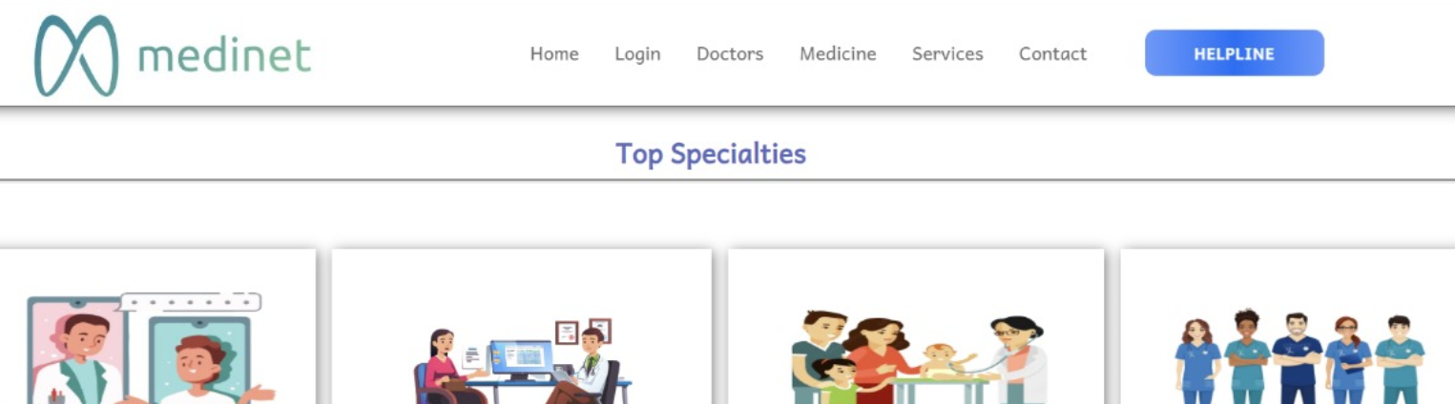
Here's what makes Medinet stand out:
Top Specialists: Discover and connect with highly rated doctors across various specialities. From dermatology to pediatrics and general physician, find the expert you need with just a few clicks.
Easy Booking and Consultation: Secure appointments, schedule virtual
consultations, and manage your healthcare
appointments effortlessly.
.

Slide 16
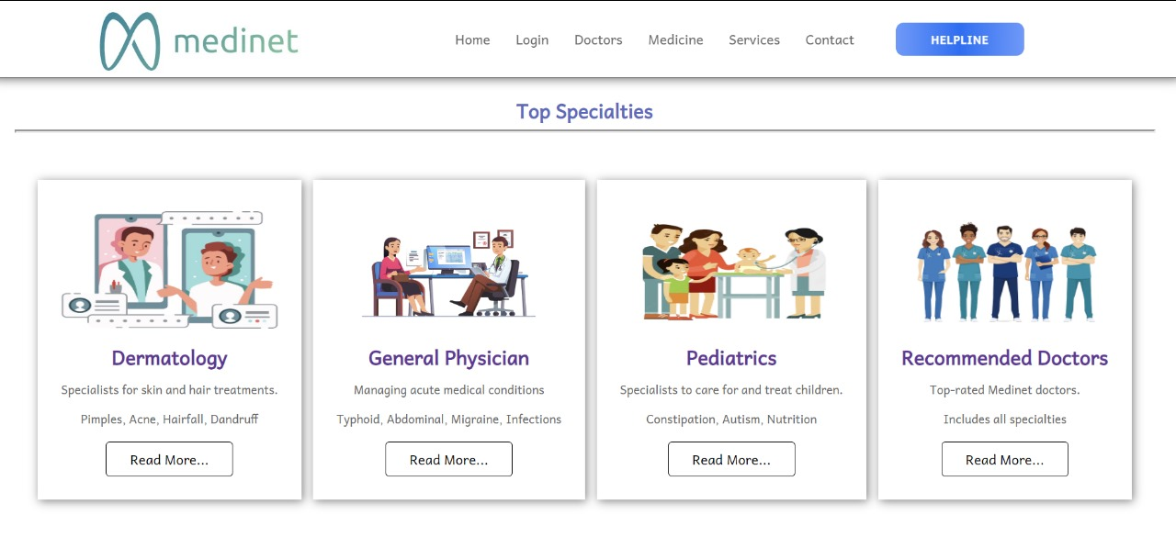
.
The website is well-designed. It showcases different specialties with clear images and concise descriptions, making it easy for visitors to understand the scope of services offered. The "Read More..." button allows users to learn more about each specialty, adding depth and information to their understanding. This transparency about the doctors and their areas of expertise builds trust with potential patients . Some other features are –
1)Intuitive Navigation: The website has a clear menu bar with links to essential sections, making it easy for users to navigate.
2)Professional Design: The overall design of the website is professional and modern, showcasing a reputable and trustworthy image.

Slide 17
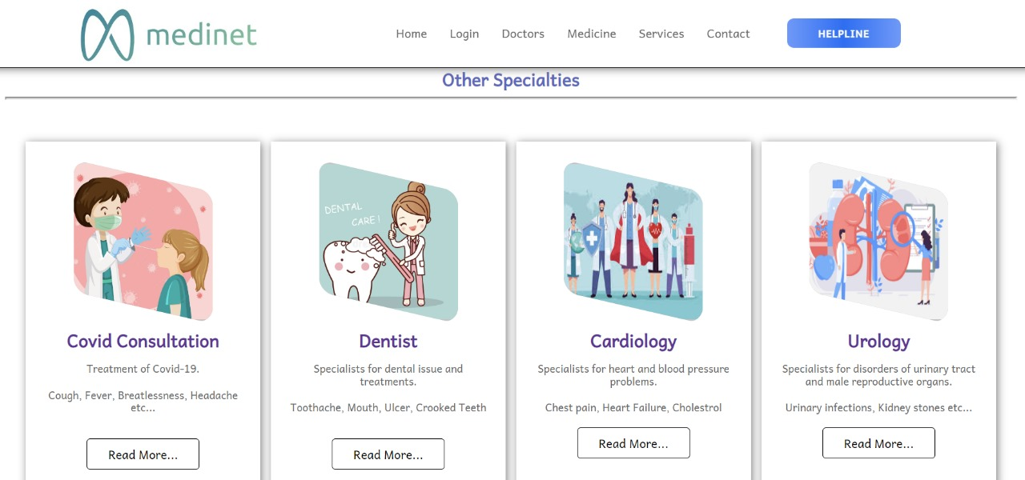
It features a user-friendly interface that allows you to easily browse through Other or different specialities, such as dermatology, general physician, pediatrics, and many more.
Here are some key advantages of using Medinet:
1) Convenient Access: You can access and explore different specialities from the comfort of your home through the website.
2) Visual Representation: The use of illustrations and graphics provides a clear and engaging understanding of each speciality.

Slide 18


Doctor Information: You can learn about the expertise of doctors in each speciality and their areas of focus.
Easy Appointment Booking: The website likely offers a simple and convenient way to book appointments with your preferred doctors.
Rating System: The "Recommended Doctors" section suggests that the website might allow users to see ratings and reviews for doctors, helping you choose the best option for your needs.

Slide 19
CONCLUSIONS
In conclusion, our hospital management website is a testament to the power of technology in revolutionizing the healthcare industry.
By providing a seamless and integrated platform for patients to access trusted doctors, medication advice , and urgent medical assistance, we are committed to delivering exceptional healthcare services that prioritize patient care and satisfaction.
With our website, patients can now take control of their health and wellness, and our healthcare professionals can focus on what they do best - providing top-notch medical care. We believe that our website will set a new standard for healthcare services, and we are excited to be at the forefront of this digital transformation.
.

Slide 20












g
“Medinet cares : We value your health and smile."

